Slide 1

Software Testing Overview

Slide 2
Contents
Basic concepts and principles of software testing
Software development lifecycle and Testing process
Software Test Types

Slide 3

Basic concepts and principles of software testing

Slide 4

2 main objectives of software testing
Measuring quality
Ensure that it is implemented and operated to meet user expectations and requirements, and discover faults
Providing information
Based on fault data, a numerical judgment basis for development project risk is communicated to the decision maker

Slide 5
Distribution of the cause of a software error
Requirement Analysis(56%)
Design(27%)
Code(10%)
Etc.(7%)

Slide 6
Principles of Software Testing
Testing shows presence of defects
Testing is an activity that reveals that a defect exists. However, it cannot be proved that there is no defect.
Exhaustive testing is impossible
Perfect testing is impossible.
Early testing
Testing from the beginning of development can ensure a high level of quality by preventing/discovery defects.
Defect clustering
The majority of defects are found in a small number of modules and cause failure.
Pesticide Paradox (살충제 역설)
After repeatedly performing the same test case, no new defects can be found.
Testing is context dependent
Testing is conducted differently depending on the context.
Absence-of-errors fallacy (오류-부재의 궤변)
Fixing many defects does not guarantee user satisfaction.

Slide 7

Software Quality property
Software Product Quality (ISO/IEC 9126)
Functionality
Reliability
Usability
Maintainability
Portability
Efficiency

Slide 8
A human being can make an error (mistake), which produces a defect (fault, bug) in the program code.
If a defect in code is executed, the system may fail to do what it should do.
Defects in software, system or documents may result in failures, but not all defects do so.

Slide 9
Software Test Type

Slide 10
Test Level
Test Level | Description
Acceptance Test | Testing to determine if the system is acceptable to the user - The purpose is not to find a fault
System Test | Functional, non-functional testing of the entire system - Performed in an environment similar to the production environment - Testing non-functional requirements such as reliability, robustness, performance, stability, and security
Integration Test | Unit(Function, Class, Component) interface testing - Run the test when each unit is combined and integrated into one system
Unit Test | independent evaluation of each unit(Function, Class, Component) - Performed by program developers in the implementation phase - Perform in situations isolated from external factors

Slide 11
Test Level in Build Center
Test Level | Traditional | LG CNS Build Center
Acceptance Test | Third-party testing Quality Gate | Accumulated Module, Smoke Test Quality Gate
System Test | Performance Test Availability Test Security check (Source security check, mock hacking) | Health Check Performance Test Availability Test Security check (Source security check, mock hacking)
Integration Test | Scenario-based | Smoke Test Module Test
Unit Test | Unit Test | Unit Test

Slide 12
Test Pyramid
Manual / Exploratory

Slide 13
Debuging log

Slide 14
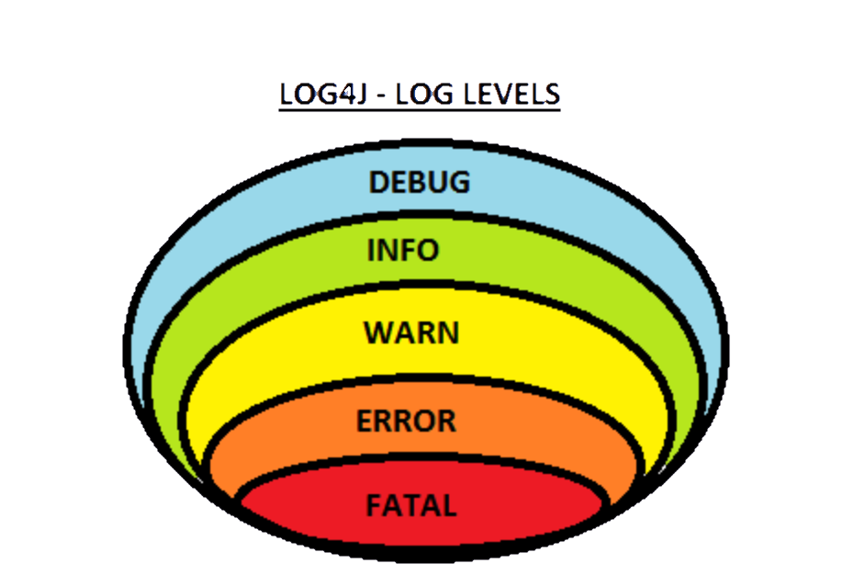
Loging level

Slide 15

Q&A

